Slide 1
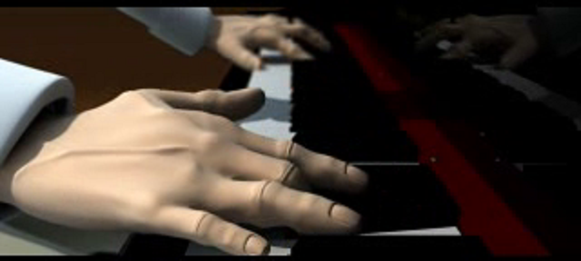
Brainstorm as many words and phrases as you can in 2 mins.

